Slide 1
Process Synchronization Lesson 2 Critical Section
David Liu
Fall 2021, Spring 2022

Slide 2
Problems to Solve
Race condition
Finish variable update without interruption
Positively, maximize data sharing opportunities with certain requirements.

Slide 3
Process Critical Section
N processes share common variables, tables or files
Each process has a Critical Section
Segment of code
Update or change common variables, tables or files
Requirement
Only one process can enter its critical section (cs)
No two processes can be its own critical section at any time

Slide 4
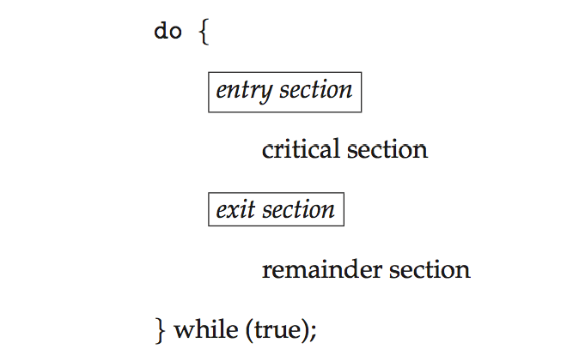
Critical Section
General structure of process P_{i}

Slide 5
Good Solution to Critical Section Problem
Mutual Exclusion - If process P_{i} is executing in its critical section, then no other processes can be executing in their critical sections
Progress - If no process is executing in its critical section and there exist some processes that wish to enter their critical section, then the selection of the processes that will enter the critical section next cannot be postponed indefinitely
Bounded Waiting - A bound must exist on the number of times that other processes are allowed to enter their critical sections after a process has made a request to enter its critical section and before that request is granted
Assume that each process executes at a nonzero speed
No assumption concerning relative speed of the n processes

Slide 6
Mutual Exclusion
If process P_{i} is executing in its critical section, then no other processes can be executing in their critical sections

Slide 7
Progress
If no process is executing in its critical section and there exist some processes that wish to enter their critical section, then the selection of the processes that will enter the critical section next cannot be postponed indefinitely

Slide 8
Bounded Waiting
A bound must exist on the number of times that other processes are allowed to enter their critical sections after a process has made a request to enter its critical section and before that request is granted

Slide 9
Shared Variable Update
Single-core environment
Multiprocessor environment

Slide 10
Shared Variable Update
Single-core environment
Disable interrupt
Multiprocessor environment
Message passing – delays

Slide 11

OS Critical Section for Kernel Data Structures
Nonpreemptive kernel
No race condition
Preemptive kernel
More responsive
Real-time programming

Slide 12
Peterson’s Solution
Classic software-based solution
Not guaranteed to work on modern architectures! (But good algorithmic description of solving the problem)
Two process solution: P₀ and P₁
Assume that the load and store machine-language instructions are atomic; that is, cannot be interrupted

Slide 13
Peterson’s Solution
The two processes share two variables:
int turn;
boolean flag[2]
The variable turn indicates whose turn it is to enter the critical section
The flag array is used to indicate if a process is ready to enter the critical section. flag[i] = true implies that process P_{i} is ready!

Slide 14
Algorithm for Process P_{i}
while (true){
flag[i] = true;
turn = j;
while (flag[j] && turn = = j)
;
/* critical section */
flag[i] = false;
/* remainder section */
}

Slide 15
P₀ Mutex Property P₁
while (true){
flag[0] = true;
turn = 1;
while (flag[1] && turn = = 1)
;
/* critical section */
flag[0] = false;
/* remainder section */
}
while (true){
flag[1] = true;
turn = 0;
while (flag[0] && turn = = 0)
;
/* critical section */
flag[1] = false;
/* remainder section */
}

Slide 16
P₀ Progress Property P₁
while (true){
flag[0] = true;
turn = 1;
while (flag[1] && turn = = 1)
;
/* critical section */
flag[0] = false;
/* remainder section */
}
while (true){
flag[1] = true;
turn = 0;
while (flag[0] && turn = = 0)
;
/* critical section */
flag[1] = false;
/* remainder section */
}

Slide 17
P₀ Bounded Waiting Property P₁
while (true){
flag[0] = true;
turn = 1;
while (flag[1] && turn = = 1)
;
/* critical section */
flag[0] = false;
/* remainder section */
}
while (true){
flag[1] = true;
turn = 0;
while (flag[0] && turn = = 0)
;
/* critical section */
flag[1] = false;
/* remainder section */
}

Slide 18
Peterson’s Solution (Cont.)
Provable that the three CS requirement are met:
1. Mutual exclusion is preserved
P_{i} enters CS only if:
either flag[j] = false
or turn = i
2. Progress requirement is satisfied
3. Bounded-waiting requirement is met
What is the bound? 1

Slide 19
Peterson’s Solution
Although useful for demonstrating an algorithm, Peterson’s Solution is not guaranteed to work on modern architectures.
Understanding why it will not work is also useful for better understanding race conditions.
To improve performance, processors and/or compilers may reorder operations that have no dependencies.
For single-threaded this is ok as the result will always be the same.
For multithreaded the reordering may produce inconsistent or unexpected results!

Slide 20
Instruction Reordering
Two threads share the data: boolean flag = false; int x = 0;
Thread 1 performs while (!flag) ; print x
Thread 2 performs x = 100; flag = true
What is the expected output?
Expected
print output: 100
If Thread 2 reordered by compiler
flag = true
x = 100;
print output: 0 or 100

Slide 21
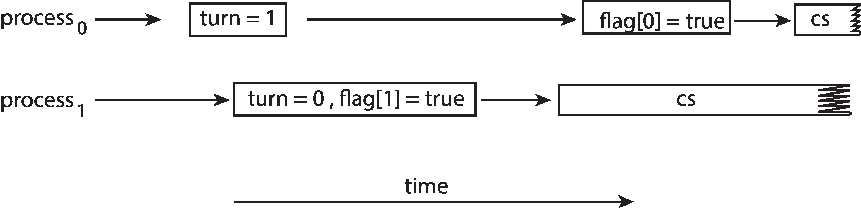
Peterson’s Solution under Reordering
The effects of instruction reordering in Peterson’s Solution
flag[1] && turn = = 1?
turn = 0
flag[0] = false
flag[0] && turn = = 0?
This allows both processes to be in their critical section at the same time!

